Slide 1


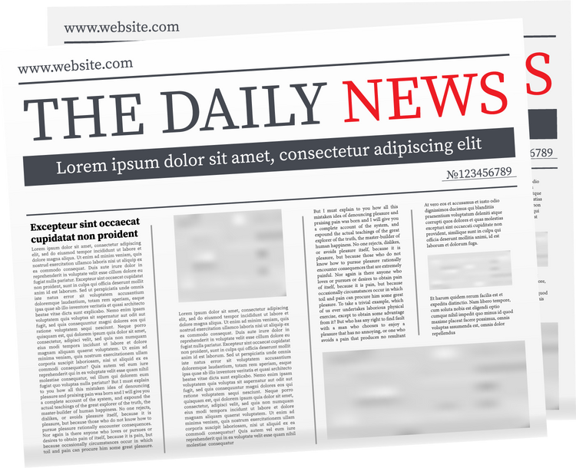
Provide Insights to Guide a Legacy Newspaper’s Survival in a Post-COVID Digital Era
Adapting to the Digital News World After COVID
An Analytical Study by Ishita Mishra

Slide 2
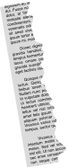
Problem Statement
Bharat Herald, a seven-decade-old multilingual newspaper, is facing a steep decline as print circulation fell from 1.2 million to under 560,000 between 2019–2024, worsened by the pandemic and rising digital-first competitors. Its failed e-paper pilot, shrinking ad revenues, bureau closures, and layoffs have deepened financial stress. With advertiser trust eroding and operations under strain, Executive Director Tony Sharma has tasked data analyst Peter Pandey to analyze five years of operational and financial data, uncover key issues, and chart a phased roadmap for Bharat Herald’s digital revival.

Slide 3
Objectives
Track circulation & revenue trends (2019–2024).
Assess print waste, ROI & city profitability.
Evaluate digital readiness vs. pilot engagement.
Prioritize cities for phased digital relaunch.
Rebuild advertiser trust & reader engagement.
Explore new revenue models for growth.

Slide 4
Business Requests

Slide 5
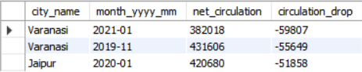
1. Monthly Circulation Drop Check
Varanasi: Net circulation dropped significantly in Jan 2021 (382K, ↓59K) and Nov 2019 (432K, ↓56K).
Jaipur: Experienced a notable drop in Jan 2020 (421K, ↓52K).

Slide 6
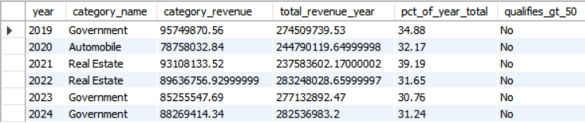
2. Yearly Revenue Concentration by Category
No category contributes more than 50% of total yearly revenue in any year.
Government is the top contributor in 2019, 2023, and 2024 (~31–35% of total revenue).
Real Estate leads in 2021–2022 (~32–39% of total revenue).
Automobile had the highest share in 2020 (~32%).

Slide 7
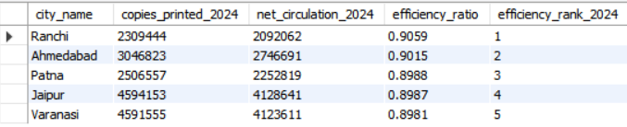
3. 2024 Print Efficiency Leaderboard
Ranchi has the highest efficiency (0.906) → most copies reaching circulation.
Ahmedabad and Patna follow closely (0.902 and 0.899).
Jaipur and Varanasi have slightly lower efficiency (~0.891 and 0.898).
All cities maintain high efficiency (>89%), indicating effective print-to-circulation conversion.

Slide 8
4. Internet Readiness Growth (2021)
Kanpur internet usage increased from 74.27% in Q1 to 76.77% in Q4.
Growth of 2.5 percentage points indicates a gradual rise in digital adoption.

Slide 9
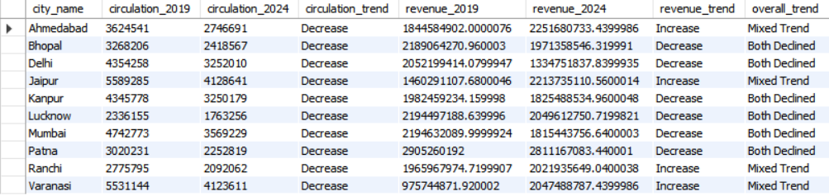
5. Consistent Multi-Year Decline (2019→2024)
All cities show declining print circulation (2019 → 2024).
Largest drops: Delhi, Mumbai, Jaipur.
Some cities’ revenue increased despite lower circulation: Ahmedabad, Jaipur, Ranchi, Varanasi.
Others show both circulation & revenue decline: Delhi, Bhopal, Kanpur, Lucknow, Mumbai, Patna.

Slide 10
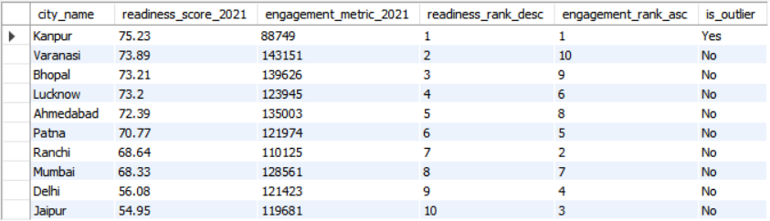
6. 2021 Readiness vs Pilot Engagement Outlier
Kanpur leads in readiness (75.23) & engagement (88,749) — outlier.
Varanasi, Bhopal, Lucknow: high readiness, moderate engagement.
Ranchi: lower readiness but high engagement — strong user activity.
Delhi & Jaipur: lowest readiness (~55), need improvement.

Slide 11
Recommendations

Slide 12
1. Digital Transition
Start with mobile app + WhatsApp bulletins in Tier-2 cities (Varanasi, Bhopal).
Expand to metros later with premium digital formats.
Long-term: shift to digital-first newsroom.

Slide 13
2. Regain Advertisers
Share transparent circulation + digital reach data.
Offer print + digital ad bundles.
Focus on FMCG & Govt. ads, rebuild auto/real estate with integrated campaigns.

Slide 14
3. Boost Digital Engagement
Daily WhatsApp bulletins (morning/evening).
Mobile-optimized e-paper with videos, polls, local languages.
Push alerts for breaking news.

Slide 15
4. Revenue Models
Print + digital bundles, family packs.
Loyalty programs with partner discounts.
Pay-per-article for premium/niche content.

Slide 16
5. Local Credibility
Partner with regional influencers/journalists.
Launch city-based video podcasts.
Encourage citizen reporting in local languages.

Slide 17
Thank You!

